Slide 1


Project 1
Exploratory Data Analysis
95-885: Big Data & Data Science
Team 5
Preet Jain & Subhav Kalra

Slide 2
Key Findings
Manhattan & Brooklyn have the highest concentration of Airbnb rental homes
Crimes have gone down in the Airbnb hotspots across NYC
The crimes mentioned in NYC are NOT the highest during the busiest months for Airbnbs
Lower rated listings with ‘safe’ in the description do not have a statistically significant difference in ratings compared to when ‘safe’ is not mentioned.
NYC Crimes are not correlated with Airbnb growth

Slide 3
Agenda
Problem Statement:
Motivation
Significance & Value proposition
Questions
Our findings
Analysis
Conclusion
Road ahead

Slide 4
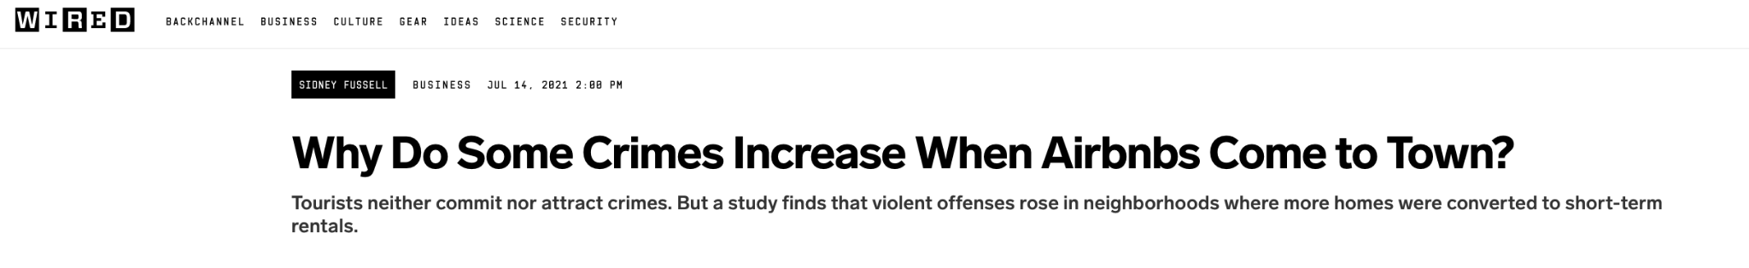
Problem Statement
Motivation:
We came across articles about the increase in crimes in NYC in Q1 of 2022 which led to the article “Why do some crimes increase when Airbnbs come to town?”
We found this particularly interesting because we saw the potential of using data to see if a short-term vacation rental company has anything to do with the crime rates in a major city such as NYC and hence, that became our hypothesis for this project.
Significance and value proposition:

Slide 5
Problem Statement
Motivation:
Significance and value proposition:
Airbnb has grown significantly over the last decade and has captured a significant share of the lodging market. With this market power comes a big responsibility and an increase in crimes falls under this responsibility.
If crimes are indeed increasing in NYC because of Airbnb, the government and Airbnb can be made aware of it so they can take the necessary steps to ensure the safety of tourists.
An example of a step that can be taken by Airbnb could be adding a “safety verified” feature for listings which also provides detailed information on how the verification process works.
Notes:
Airbnb has grown significantly over the last decade and has captured a significant share of the lodging market. With this market power comes a big responsibility and an increase in crimes falls under this responsibility.
If crimes are indeed increasing in NYC because of Airbnb, the government and Airbnb can be made aware of it so they can take the necessary steps to ensure the safety of tourists.
An example of a step that can be taken by Airbnb could be adding a “safety verified” feature for listings which also provides detailed information on how the verification process works.

Slide 6
Agenda
Problem Statement:
Motivation
Significance & Value proposition
Questions
Our findings
Analysis
Conclusion
Road ahead

Slide 7
Questions
Have crimes increased in Airbnb hotspots?*
How are the top 3 crimes in terms of count spread across the months of the year? Are they high during the busiest month for Airbnb hosts?
For the lower rated listings if the description includes the word ‘safe’, what is the average rating compared to when the word ‘safe’ is NOT mentioned?
* This question required some sub-questions to be answered which are described in detail in a later section

Slide 8
Agenda
Problem Statement:
Motivation
Significance & Value proposition
Questions
Our findings
Analysis
Conclusion
Road ahead

Slide 9
Questions
Have crimes increased in Airbnb hotspots?
How are the top 3 crimes in terms of count spread across the months of the year? Are they high during the busiest month for Airbnb hosts?
For the lower rated listings if the description includes the word ‘safe’, what is the average rating compared to when the word ‘safe’ is NOT mentioned?

Slide 10
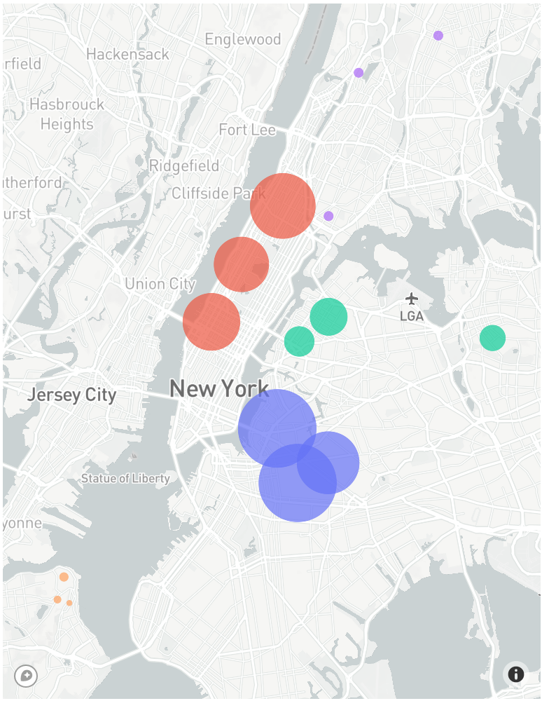
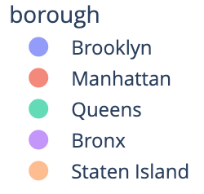
Manhattan & Brooklyn have the highest concentration of Airbnb rental homes
The top Airbnb neighborhood in NYC is Williamsburg.
The top 3 neighborhoods in each borough are:
Brooklyn: Williamsburg, Bedford-Stuyvesant, Bushwick
Manhattan: Harlem, Upper west side, Hell’s kitchen
Queens: Astoria, Long Island city, Flushing
Bronx: Mott Haven, Kingsbridge, Wakefield
Staten Island: St. George, Tompkinsville, Stapleton

Slide 11
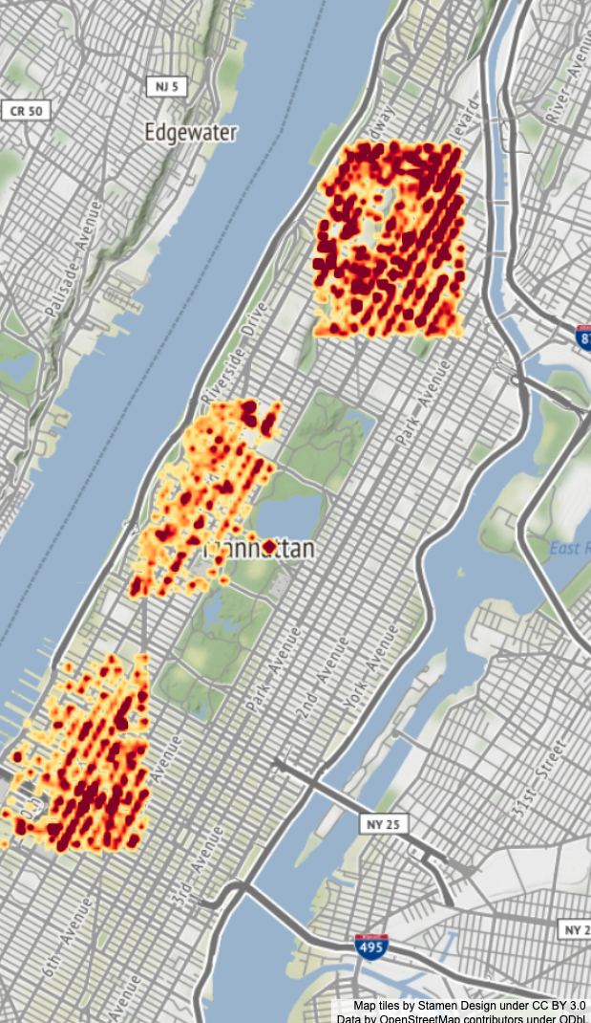
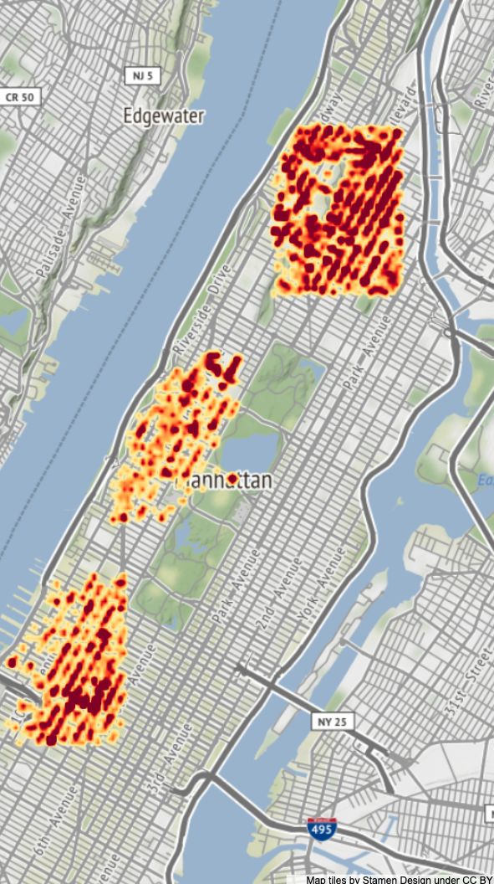
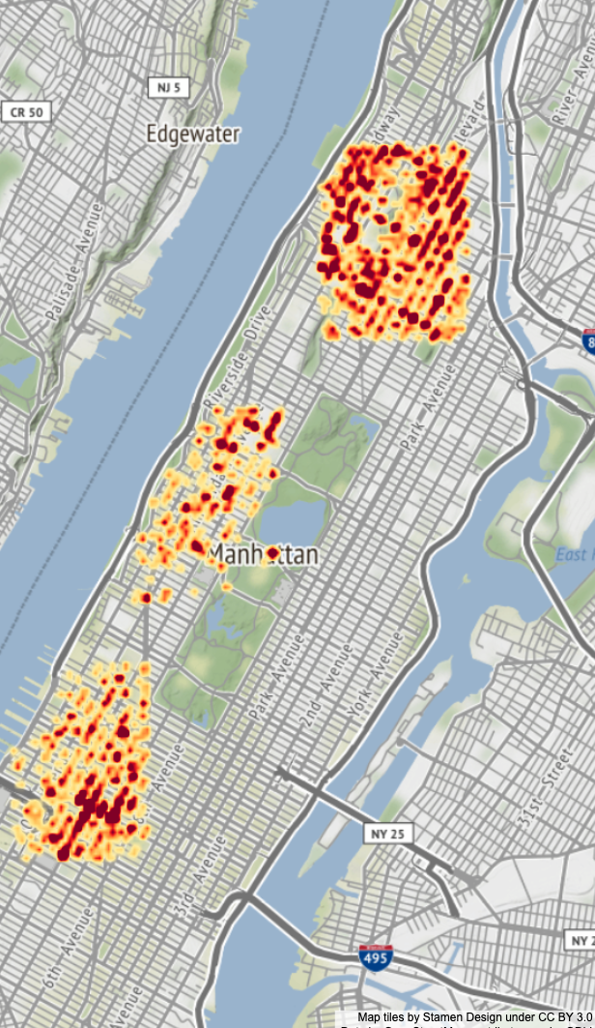
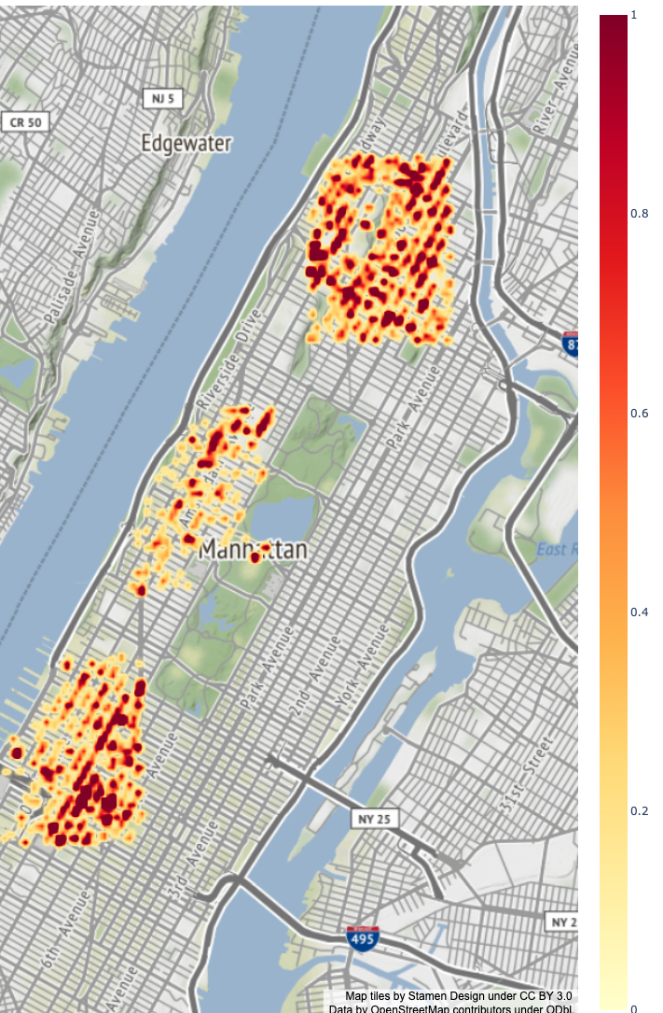
Crimes have gone down in the Airbnb hotspots in Manhattan & Brooklyn
Dangerous weapons, offense against public order and robbery crimes heatmap in Manhattan
1
The top 3 crime categories, identified by article were: Dangerous weapons, offense against public order and robberies.
The crimes in these categories have reduced in the Airbnb Hotspots in Manhattan
0.8
0.6
0.4
0.2
0
2006
2010
2014
2018

Slide 12
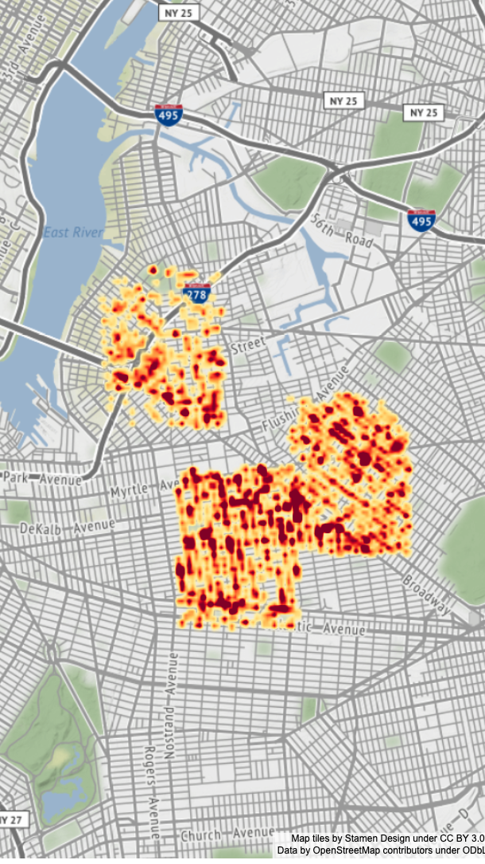

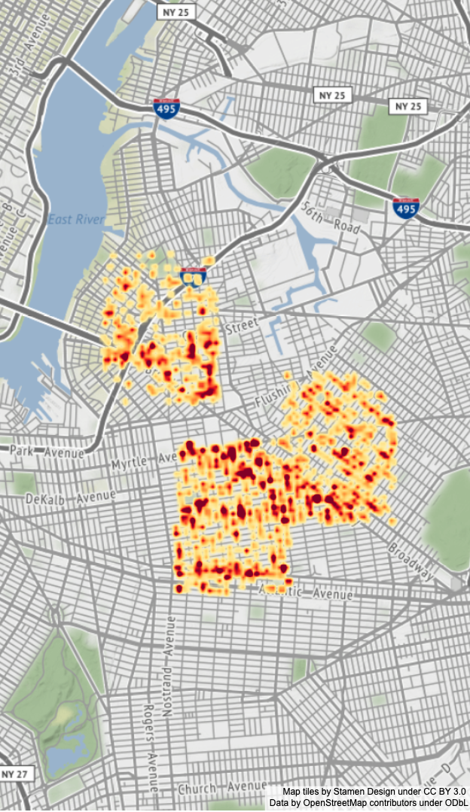
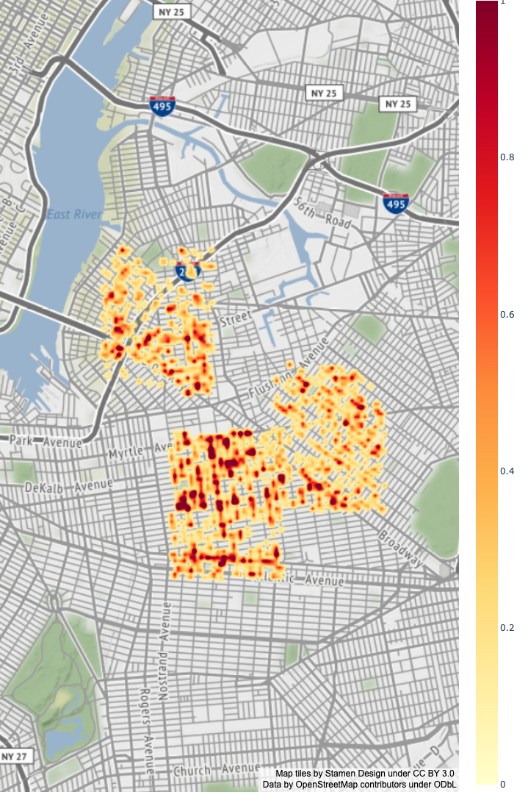
Crimes have gone down in the Airbnb hotspots in Manhattan & Brooklyn
Dangerous weapons, offense against public order and robbery crimes heatmap in Brooklyn
1
0.8
0.6
The crimes in these categories have reduced in the Airbnb Hotspots in Brooklyn
0.4
0.2
0
2006
2010
2014
2018

Slide 13
Questions
Have crimes increased in Airbnb hotspots?
How are the top 3 crimes in terms of count spread across the months of the year? Are they high during the busiest month for Airbnb hosts?
For the lower rated listings if the description includes the word ‘safe’, what is the average rating compared to when the word ‘safe’ is NOT mentioned?

Slide 14
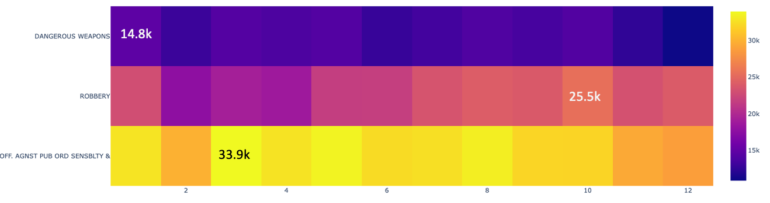
The crimes mentioned in the article are NOT the highest in the busiest months for Airbnbs
Month
Busiest months for travel to NYC are June - August* Highest crimes under each examined category were reported in the following months:
January: Dangerous weapons
October: Robbery
March: Offense against public order
*Source

Slide 15
Questions
Have crimes increased in Airbnb hotspots?
How are the top 3 crimes in terms of count spread across the months of the year? Are they high during the busiest month for Airbnb hosts?
For the lower rated listings if the description includes the word ‘safe’, what is the average rating compared to when the word ‘safe’ is NOT mentioned?

Slide 16
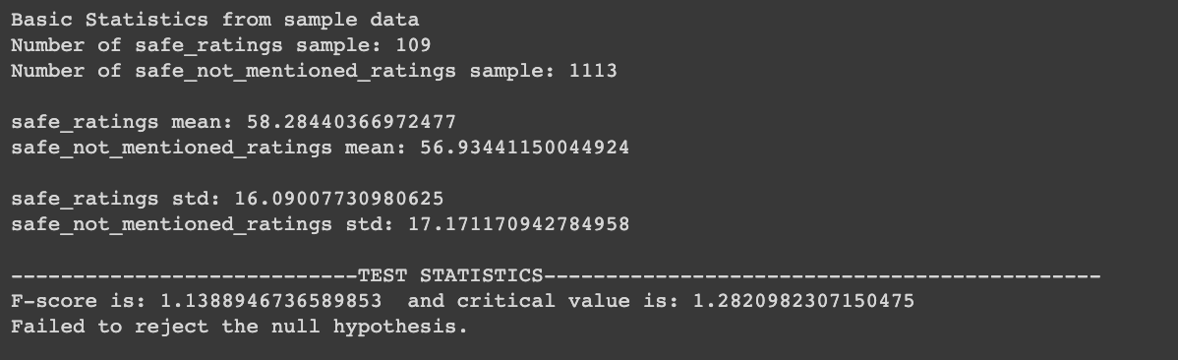
Ratings are higher for lower rated listings that mention the word 'safe' in their description but the difference is statistically insignificant
H₀: μ_ratings_{safe} = μ_ratings_{safe_not_mentioned}
H_{a}: μ_ratings_{safe} > μ_ratings_{safe_not_mentioned}
Based on the test statistics, we rejected the null hypothesis.

Slide 17
Agenda
Problem Statement:
Motivation
Significance & Value proposition
Questions
Our findings
Analysis
Conclusion
Road ahead

Slide 18
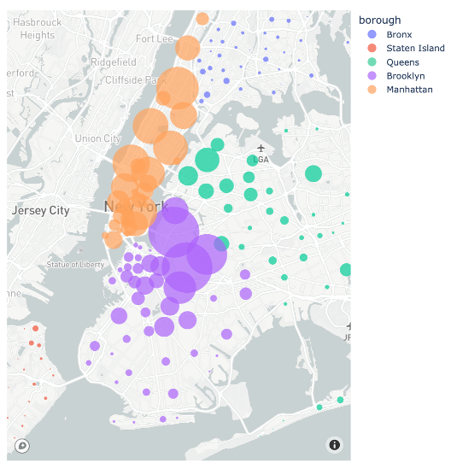
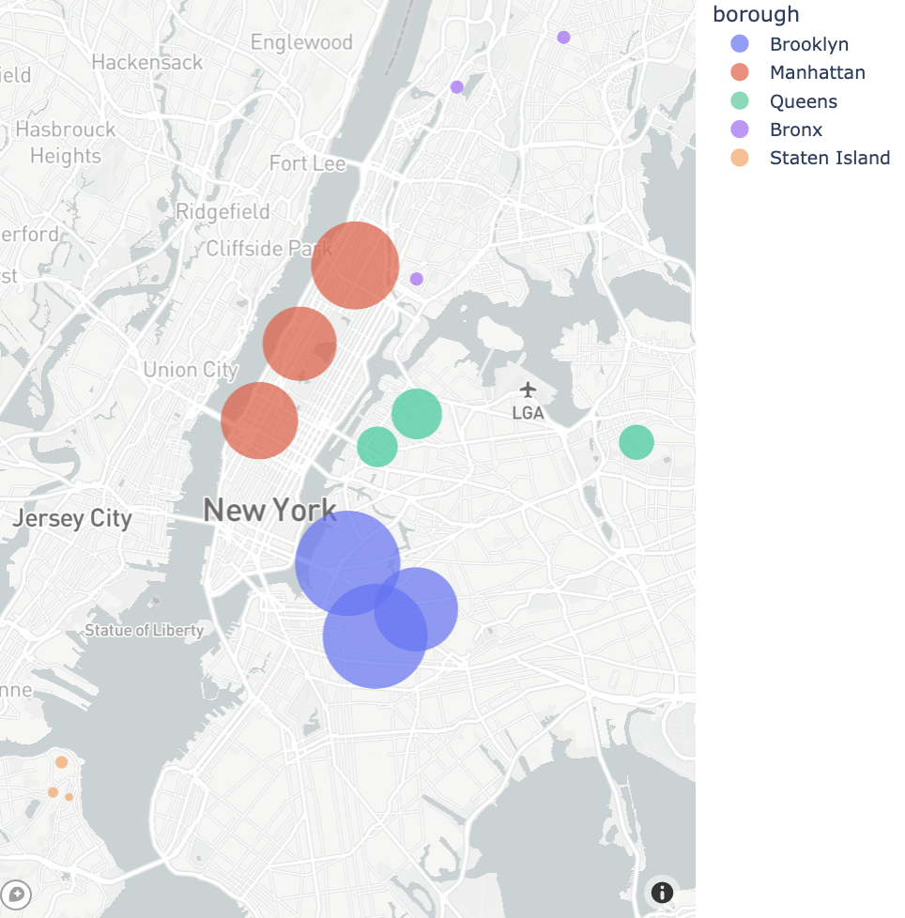
Airbnbs are concentrated largely in Manhattan, Brooklyn and Queens
For our analysis, we looked at the top 3 Airbnb neighborhoods in the top 3 boroughs – Manhattan, Brooklyn and Queens. We then went on to focus on the crimes within these neighborhoods

Slide 19
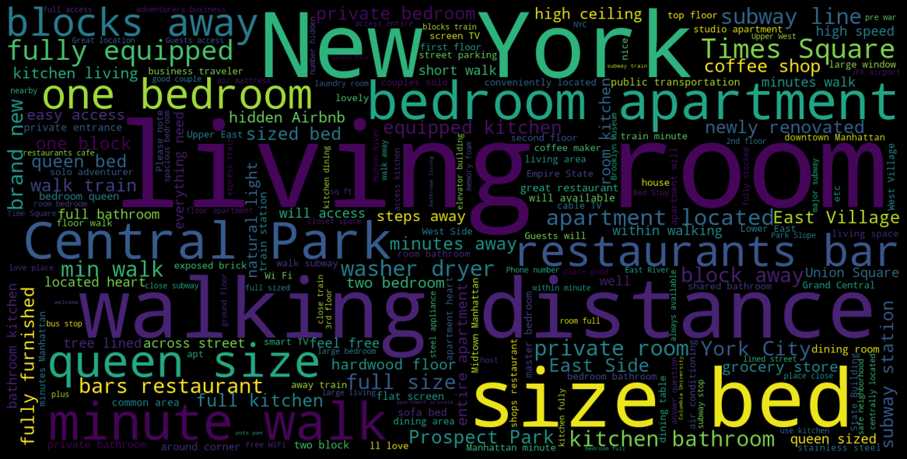
Word cloud analysis to see if any keywords related to crime (e.g., ‘safe’) appear in the description
The most common words in the description relate to the Airbnb itself in terms of living room, bed size, location, etc.
Manhattan was part of the word cloud but interestingly, the landmarks in Manhattan were mentioned very frequently as well, confirming that Manhattan has the highest concentration of Airbnbs.

Slide 20
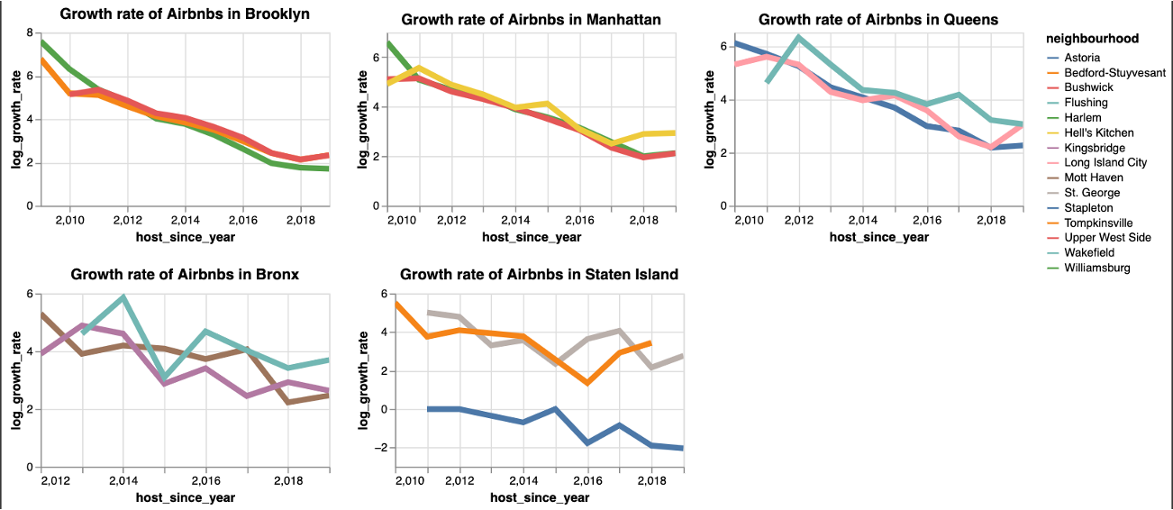
The growth rate of Airbnb listings in top neighborhoods is on the decline
Even though the overall count of Airbnb listings in the top neighborhoods increased, the growth rate fell y-o-y from 2010-2018

Slide 21
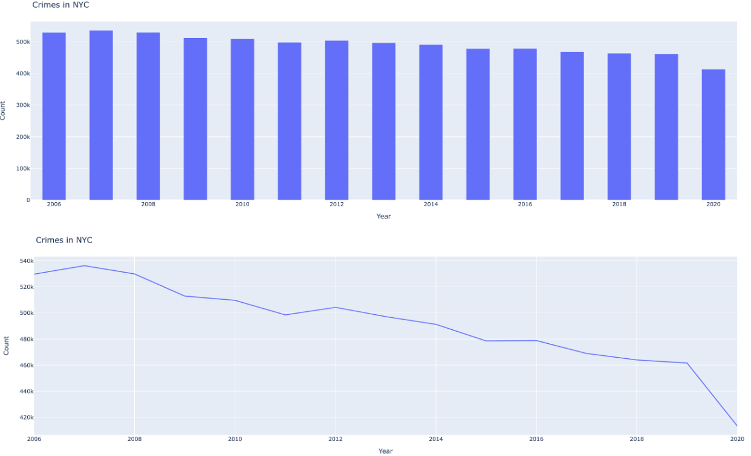
Crimes overall NYC have fallen from 2008 to 2020
The count of crimes has fallen in NYC year on year with 2020 constituting the lowest crime rates, perhaps due to the Covid-19 outbreak

Slide 22
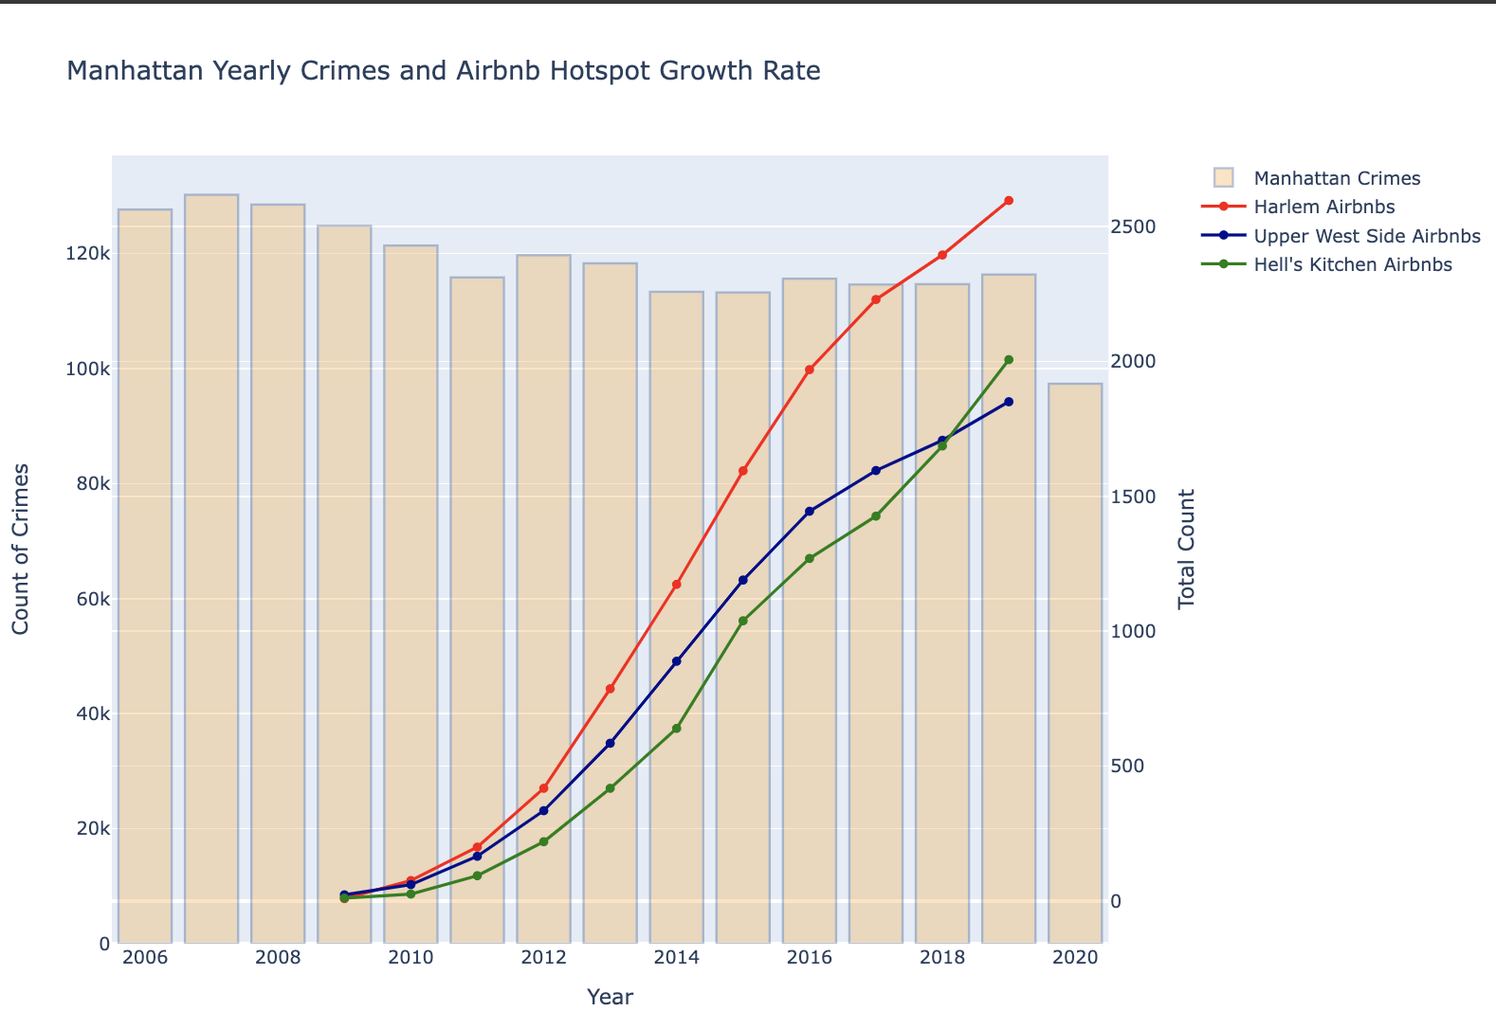
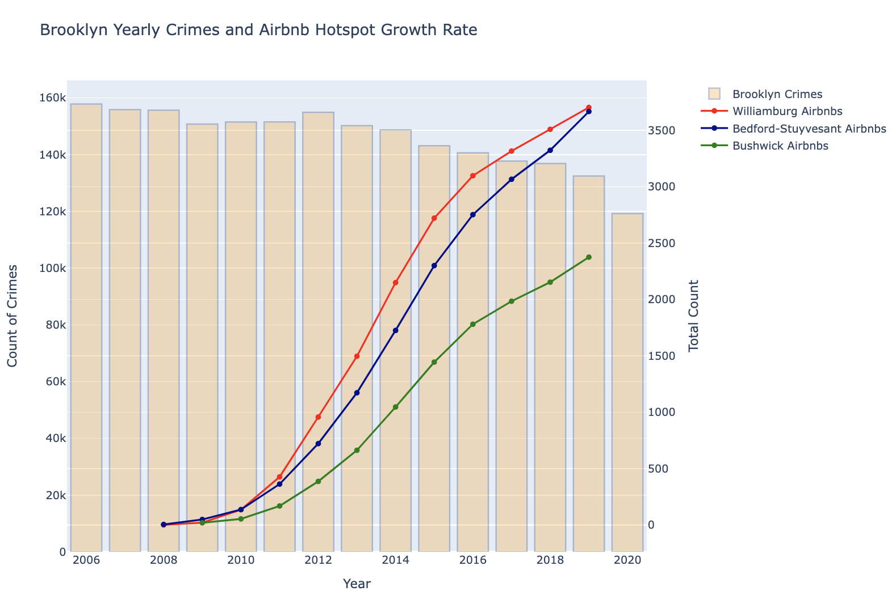
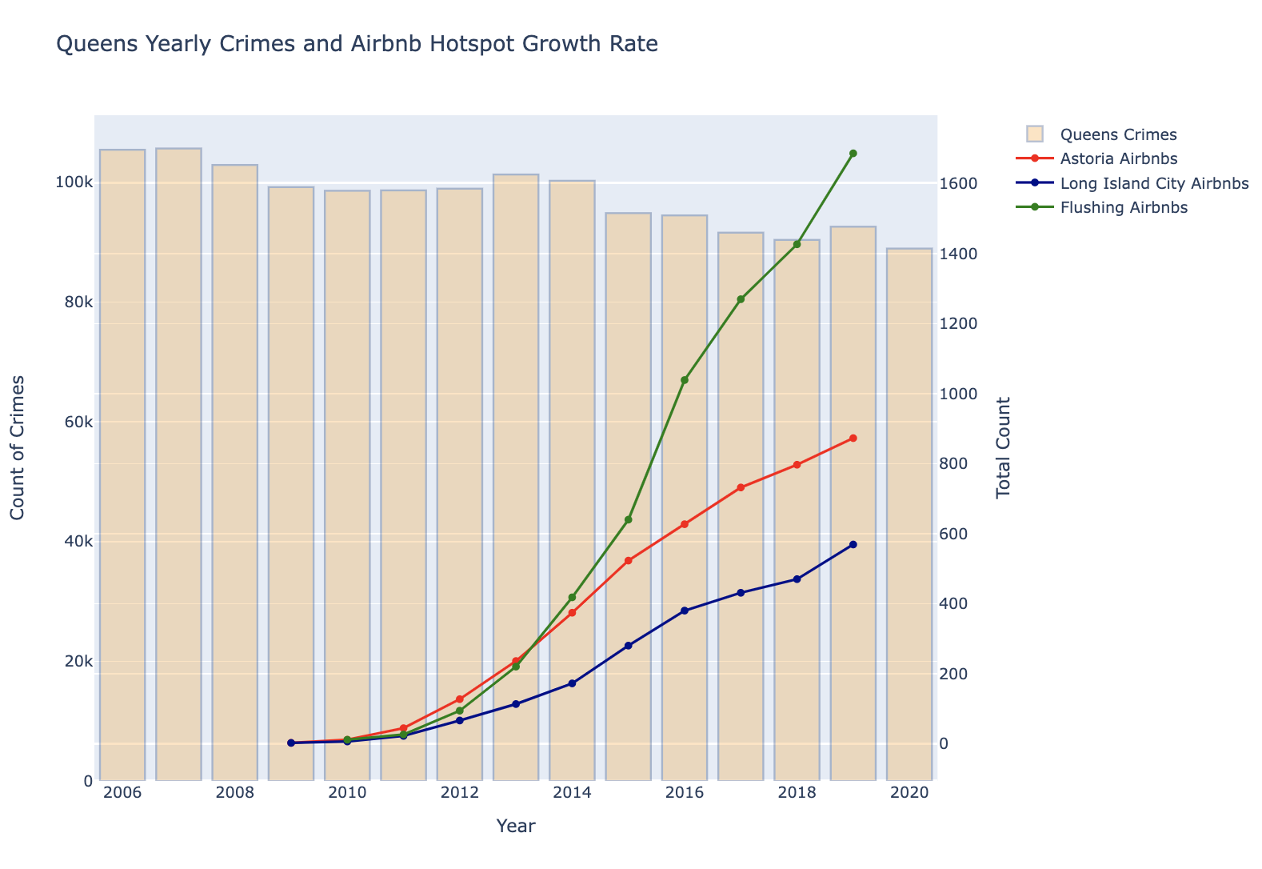
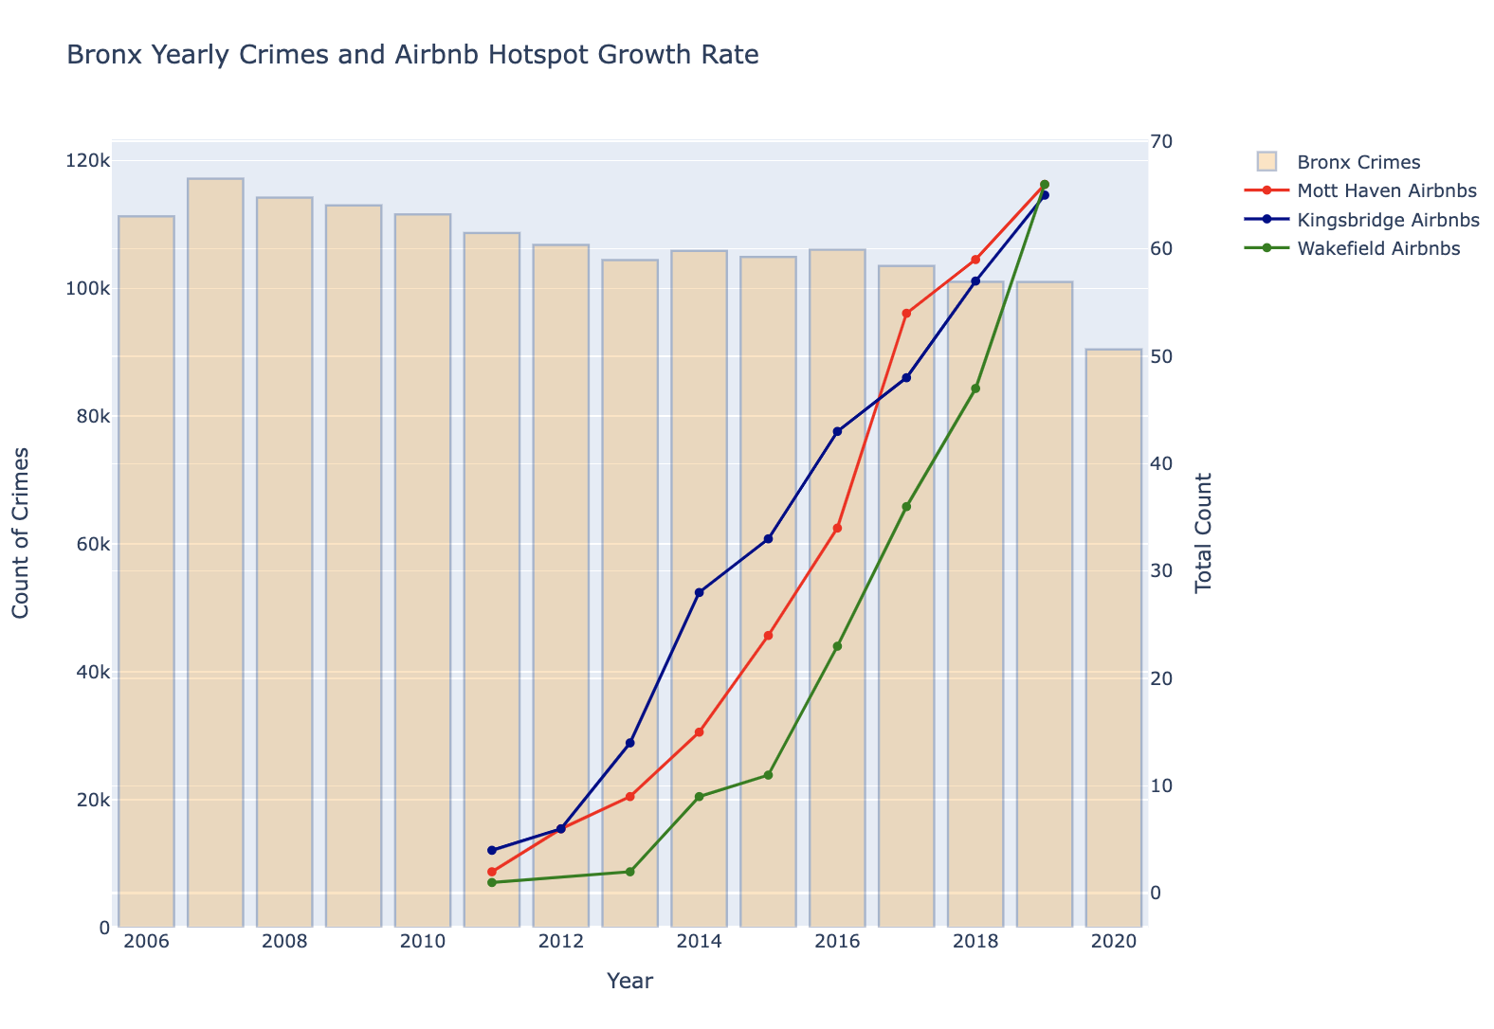
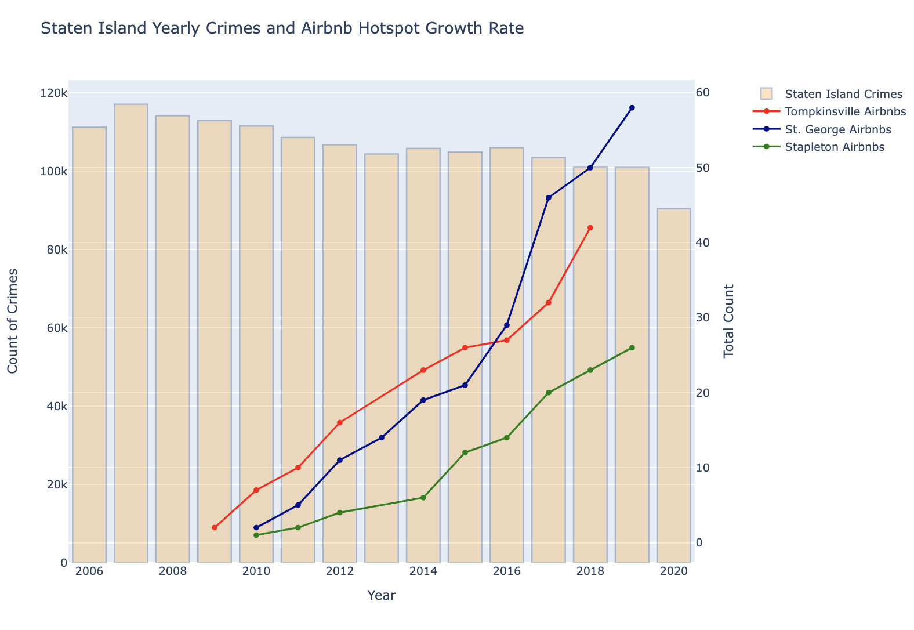
Crime rates decreased in the top neighborhoods with an increase in the count of Airbnb listings
In the top neighborhoods across all 5 boroughs, as the count of Airbnbs increased y-o-y, the crime rates were falling

Slide 23
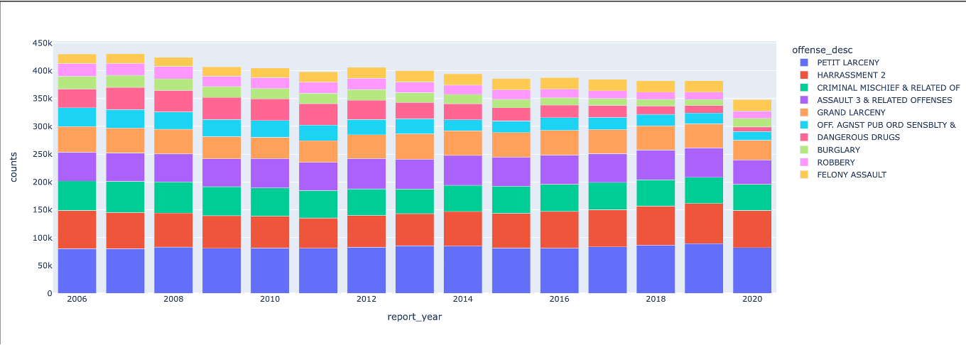
Crime rates decreased in the top neighborhoods with an increase in the count of Airbnb listings
The major crime offense categories: Petit Larceny, Harassment, Criminal mischief, Assault 3 and grand larceny largely remained the same in count even though the overall crimes were falling

Slide 24
Agenda
Problem Statement:
Motivation
Significance & Value proposition
Questions
Our findings
Analysis
Conclusion
Road ahead

Slide 25
Conclusion
Increase in Airbnb hotspots has NOT triggered crimes under the categories: offense against public order, dangerous weapons and robberies
There is no statistical significance in the mentions of the word ‘safe’ and lower rated Airbnb listings
Crimes have in fact gone down in the top Airbnb clusters
This could perhaps be due to increased police patrol in and around the rental sharing homes
Crimes are NOT the highest in the busiest tourist months
According to our heatmap analysis, the Airbnb related crimes *, occurred most in months in which relatively fewer tourists visit NYC
*Crimes occurring around Airbnb hotspots according to the article

Slide 26
Agenda
Problem Statement:
Motivation
Significance & Value proposition
Questions
Our findings
Analysis
Conclusion
Road ahead

Slide 27

Road ahead
A next step for this analysis would be to develop: A Machine Learning model that uses the description information, ratings information and, the crimes information and labels listings as safe or not.
This is a feature (safety verified by Airbnb) that Airbnb could implement on their portal to help tourists get a better sense of the neighborhood in which the Airbnb is located.

